Slide 1
SMART clinical trial design for large and small samples
May 19, 2019, SCT Pre-Conference Workshop
Kelley M Kidwell, PhD & Roy Tamura, PhD
DESCRIPTION: Sequential, multiple assignment, randomized trials (SMARTs) have been implemented in oncology, drug abuse, ADHD, obesity, depression, insomnia, autism, and smoking cessation, among other areas. A SMART is a multi-stage trial design that allows for individuals to be randomized at two or more stages based on intermediate outcomes. SMART design has primarily been focused on informing the construction of dynamic treatment regimens (DTRs) or adaptive interventions. DTRs are sequences of decision rules that specify whether, how, for whom, or when to alter the dose, type, or delivery of pharmacological, behavioral, and/or psychosocial treatments. DTRs are evidence based treatment guidelines where treatment can be altered over time based on the individual. The majority of SMARTs are conducted in large samples and analyzed using frequentist methods. More recently, Bayesian and frequentist methods have been developed to apply the SMART design in small samples to find the best overall treatment sharing information across stages. These methods in small samples may also be extended to find the most effective dynamic treatment regimens. This workshop will introduce SMART design for both large and small samples. Case studies will be used as examples and R and SAS code will be provided for practice.

Slide 2
Outline
8-8:15 Introductions
8:15-9:30 Intro to DTRs and SMARTs
9:30-945 SMART Exercise
9:45-10:15 Refreshment Break
10:15-11:10 SMART Design Principles
11:10-12 Small Sample SMARTs

Slide 3
Introductions

Slide 4
Dynamic Treatment Regimens

Slide 5
Objectives
Definition of dynamic treatment regimen (DTR)
Why use DTRs?
Design goals for DTRs

Slide 6
Dynamic Treatment regimens aka
Adaptive interventions
Adaptive health interventions
Adaptive treatment strategies
Individualized interventions
Protocolized treatment sequences
Stepped care models
Treatment algorithms
Treatment protocols

Slide 7
How do health providers treat patients in real life?
Ongoing care and follow up
Therapies are not set in stone
Therapies can be changed, intensified, discontinued
Treatment decisions can be based on health progress, treatment adherence, side effects, and patient choice

Slide 8
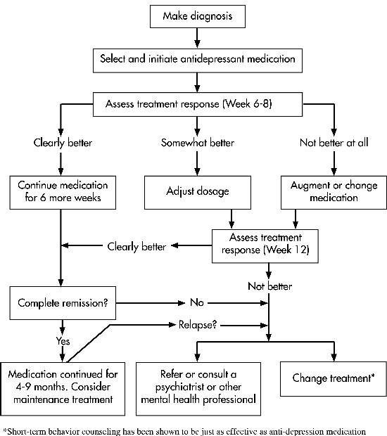

Slide 9
Definition of DTR
Sequence of decision rules that guide
whether, how, or when and based on which measures
to alter the dosage (duration, frequency or amount),
type or delivery of treatment(s)
at decision stages in the course of care

Slide 10
Examples of DTRs
Leukemia:
First receive standard chemotherapy.
If the patient responds to chemotherapy and achieves remission, then receive maintenance treatment cytarabine;
if remission is not achieved, there is no further treatment.

Slide 11
Examples of DTRs
Prostate Cancer:
First receive combination chemotherapy paclitaxel + estramustine + etoposide (TEC).
If successful (a decrease of 40% or more in PSA from baseline at diagnosis, with no evidence of disease progression at any site) at 8 weeks, then continue TEC;
otherwise switch to cyclophosphamide + vincristine + dexamethasone (CVD).

Slide 12
Examples of DTRs
Autism
First treat with joint attention, symbolic play engagement and regulation therapy for 2 1-hr sessions/week at a clinic for 12 weeks.
At the end of week 12 determine early sign of response based on social communication tests. If slow responder, add a speech generating device to therapy for 12 weeks
If responding, maintain therapy for 12 weeks

Slide 13
DTR Elements
Decision points: a time in which treatment options should be considered based on patient information
Tailoring Variable: patient information used to make treatment decisions (includes intermediate outcome)
Intervention Options: type/dose of treatment
Decision Rules: If/then rules
Outcomes: short-term goal of decision rules (proximal) and/or long-term goal of intervention (distal)

Slide 14
Example: A patient presents with cancer
Pazopanib
Disease
progression
Stable disease, partial or complete response
Everolimus
Continue pazopanib
Notes:
Metastatic kidney cancer

Slide 15
DTR Elements
Pazopanib
Decision points: assessment times
Disease
progression
Stable disease, partial or complete response
Everolimus
Continue pazopanib

Slide 16
DTR Elements
Pazopanib
Tailoring
Variable: tumor size
Disease
progression
Stable disease, partial or complete response
Everolimus
Continue pazopanib

Slide 17
DTR Elements
Pazopanib
Disease
progression
Stable disease, partial or complete response
Everolimus
Continue pazopanib
Decision rule: What interventions are given to each group?

Slide 18
DTR Elements
Pazopanib
Intervention options: treatment
Disease
progression
Stable disease, partial or complete response
Everolimus
Continue pazopanib

Slide 19
DTR Elements
Pazopanib
Disease
progression
Stable disease, partial or complete response
Everolimus
Continue pazopanib
Primary outcome: overall goal for DTR, e.g. time to progression

Slide 20
Who is involved in DTRs
Patient – sequence of treatments based on your own response over time
Health provider – sequence of decision rules that recommend what treatment to offer at each critical decision point for any patient under your care, guided by how each patient responds
Researcher/scientist – develops the DTR to be used by clinicians to guide their decision making in clinical practice; answers open scientific questions regarding design of DTRs

Slide 21
When are DTRs useful?
Waxing and waning of disease/disorder
No widely effective treatment
Treatments may be costly or burdensome
Adherence problems
Within and between person heterogeneity

Slide 22
Scientific questions in DTR design
What is the best initial treatment?
When should a decision be made to adapt the treatment?
When is the best time for a decision point? Fixed or floating?
Should we use a lenient definition of responder or a strict definition?
What is the best subsequent treatment among non-responders?
What is the best subsequent treatment among responders?

Slide 23
Sequential Multiple Assignment Randomized Trials

Slide 24
Objectives: Part 1
What is a SMART?
SMART vs. other trial designs
Alternative approaches to a SMART

Slide 25
How can we construct better DTRs
What are the treatment options at each step?
What should be the timing of the steps?
What information (variables) should be used to select an option and/or timing for each step?
How should many such variables be summarized to create decision rules that make sense to clinicians and patients?
What is the best sequence of steps?
Can results from a trial be used to develop and refine DTRs to individualize treatment?

Slide 26
What is a Smart?
A multi-stage randomized trial
Each stage corresponds to a critical decision point
A randomization takes place at each critical decision
Each participant moves through the multiple stages
Goal: to inform the construction of dynamic treatment regimens

Slide 27
Randomization and Perspective
Randomization:
allows for valid causal inferences about effectiveness of treatments without having to make unverifiable assumptions
Provides basis for identifying important individualization (tailoring) variables at each step (variables that affect outcome differentially by treatment at that step)
Original Perspective:
SMART is used to develop DTRs – evaluate components of DTRs – Phase II
“winning” DTR is then compared to “standard of care”/appropriate alternative in a confirmatory RCT
Other Perspective:
SMARTs can be confirmatory and compare DTRs
Notes:
Standard of care could be non-adaptive regimen or another adaptive regimen, could come from SMART or what physicians did previously
In original perspective, you focused on building the DTRs, you didn’t power to compare them, so you’d have to do a follow up trial to power for comparing DTRs
Other perspective: limited resources, think we know the best pieces, let’s power on the DTRs
Will discuss power/sample size in more detail in second part of this module

Slide 28
SMARTS in the field
Oncology
Drug abuse
ADHD
Alcoholism
Obesity
OCD
Autism
Schizophrenia
Depression
Insomnia
Bipolar
Conduct problems
Smoking cessation
Suicide prevention
https://methodology.psu.edu/ra/adap-inter/projects

Slide 29
Motivating Example
Setting: Kidney cancer, Phase II
Sequential Two-agent Assessment in Renal Cell Carcinoma Therapy
Thall & Tannir https://clinicaltrials.gov/ct2/show/study/NCT01217931
Compare several targeted agents in a randomized fashion
Different agents given consecutively may have interactive effects
Select two agent strategies for later evaluation in a large scale phase III trial

Slide 30
Motivating Example
Setting: Kidney cancer
What physicians do in practice: treat patient first with a treatment and follow the patient to see if the treatment works and if not, treat with something else
What we have: At onset of disease (front-line treatments), treatments P, E, and B have been approved to treat kidney cancer.
What we need:
What is the best initial treatment (P, E, or B) in a treatment regimen?
What is the best treatment for those who do not initially respond?
What is the best DTR?

Slide 31
SMART: Case Study #1
Responders
Continue
Pazopanib
Non-responders
Everolimus
R
Bevacizumab
Responders
Continue
R
Everolimus
Non-responders
Pazopanib
Entry
R
Bevacizumab
Responders
Continue
Bevacizumab
Non-responders
Pazopanib
R
Everolimus
T = 0
T = 1
T = 5 years
Notes:
P, B are VEGF pathway inhibitors – block the tumor’s blood supply
E inhibits rapamycin (mTOR) pathway which is a central regulator of cell metabolism, growth, proliferation and survival

Slide 32
DTR Components of interest/SMART Treatments
Treatments: Targeted therapies (open label)
Pazopanib- block a protein that may cause uncontrolled tumor growth, prevent cancer from growing and spreading; oral
Bevacizumab- block growth of blood vessels that supply nutrients for tumor growth, prevent or slow growth of cells; IV
Everolimus- inhibits rapamycin (mTOR) pathway- central regulator of cell metabolism, growth, proliferation and survival; block growth of cells; oral
At start of the trial, pazopanib was an established standard for frontline and everolimus an established standard for second line treatment: (p,e) may be considered a “control” arm
Notes:
Collaborating with Novartis

Slide 33
Motivation
The goal of this phase II trial is to compare 6 different 2-drug sequences of everolimus, bevacizumab, or pazopanib to learn how they may affect metastatic kidney cancer. Researchers will also study the safety of these 2-drug sequences.
(P,B)
(P,E)
(B,P)
(B,E)
(E,P)
(E,B)
Notes:
*NOTE each pair of treatments in parentheses denotes a DTR where we assume the responders continue the initial treatment

Slide 34
Outcomes
Stage 1 outcome: time to overall treatment failure- date of randomization to date of disease progression or worsening compared to baseline, discontinuation of treatment for any reason or death
Stop taking initial drug, start 2nd drug 2-4 weeks later
Overall outcome: time to overall treatment failure- date of randomization to date of second disease progression, drop out from protocol treatment for any reason or death

Slide 35
Study Visits
Every week during weeks 1-4: Blood pressure (P or B)
Every 2 weeks: urine (B)
Every 4 weeks: physical exam, performance status, blood, urine
Every 8 weeks: CT scan, QOL questionnaires
Every year: MRI of brain, ECHO/MUGA of heart
Re-randomized: any point of progression up to 1 year

Slide 36
SMART: Case Study 1
Responders
Continue
Pazopanib
Non-responders
Everolimus
R
Bevacizumab
Responders
Continue
R
Everolimus
Non-responders
Pazopanib
Entry
R
Bevacizumab
Responders
Continue
Bevacizumab
Non-responders
Pazopanib
R
Everolimus
T = 0
T = 1
T = 5 years
Notes:
P, B are VEGF pathway inhibitors – block the tumor’s blood supply
E inhibits rapamycin (mTOR) pathway which is a central regulator of cell metabolism, growth, proliferation and survival

Slide 37
Embedded DTRs
First begin with P, if you respond continue P, if you do not respond, switch to B
First begin with P, if you respond continue P, if you do not respond, switch to E
First begin with E, if you respond continue E, if you do not respond, switch to B
First begin with E, if you respond continue E, if you do not respond, switch to P
First begin with B, if you respond continue B, if you do not respond, switch to P
First begin with B, if you respond continue B, if you do not respond, switch to E

Slide 38
DTRS
Responders
Continue
Pazopanib
Non-responders
Everolimus
R
Bevacizumab
Responders
Continue
R
Everolimus
Non-responders
Pazopanib
Entry
R
Bevacizumab
Responders
Continue
Bevacizumab
Non-responders
Pazopanib
R
Everolimus
months
T = 0
T = 1
T = 5 years
Notes:
P, B are VEGF pathway inhibitors – block the tumor’s blood supply
E inhibits rapamycin (mTOR) pathway which is a central regulator of cell metabolism, growth, proliferation and survival

Slide 39
DTRS
Responders
Continue
Pazopanib
Non-responders
Everolimus
R
Bevacizumab
Responders
Continue
R
Everolimus
Non-responders
Pazopanib
Entry
R
Bevacizumab
Responders
Continue
Bevacizumab
Non-responders
Pazopanib
R
Everolimus
months
T = 0
T = 1
T = 5 years
Notes:
P, B are VEGF pathway inhibitors – block the tumor’s blood supply
E inhibits rapamycin (mTOR) pathway which is a central regulator of cell metabolism, growth, proliferation and survival

Slide 40
DTRs
Responders
Continue
Pazopanib
Non-responders
Everolimus
R
Bevacizumab
Responders
Continue
R
Everolimus
Non-responders
Pazopanib
Entry
R
Bevacizumab
Responders
Continue
Bevacizumab
Non-responders
Pazopanib
R
Everolimus
months
T = 0
T = 1
T = 5 years
Notes:
P, B are VEGF pathway inhibitors – block the tumor’s blood supply
E inhibits rapamycin (mTOR) pathway which is a central regulator of cell metabolism, growth, proliferation and survival

Slide 41
DTRs
Responders
Continue
Pazopanib
Non-responders
Everolimus
R
Bevacizumab
Responders
Continue
R
Everolimus
Non-responders
Pazopanib
Entry
R
Bevacizumab
Responders
Continue
Bevacizumab
Non-responders
Pazopanib
R
Everolimus
months
T = 0
T = 1
T = 5 years
Notes:
P, B are VEGF pathway inhibitors – block the tumor’s blood supply
E inhibits rapamycin (mTOR) pathway which is a central regulator of cell metabolism, growth, proliferation and survival

Slide 42
DTRs
Responders
Continue
Pazopanib
Non-responders
Everolimus
R
Bevacizumab
Responders
Continue
R
Everolimus
Non-responders
Pazopanib
Entry
R
Bevacizumab
Responders
Continue
Bevacizumab
Non-responders
Pazopanib
R
Everolimus
months
T = 0
T = 1
T = 5 years
Notes:
P, B are VEGF pathway inhibitors – block the tumor’s blood supply
E inhibits rapamycin (mTOR) pathway which is a central regulator of cell metabolism, growth, proliferation and survival

Slide 43
DTRs
Responders
Continue
Pazopanib
Non-responders
Everolimus
R
Bevacizumab
Responders
Continue
R
Everolimus
Non-responders
Pazopanib
Entry
R
Bevacizumab
Responders
Continue
Bevacizumab
Non-responders
Pazopanib
R
Everolimus
months
T = 0
T = 1
T = 5 years
Notes:
P, B are VEGF pathway inhibitors – block the tumor’s blood supply
E inhibits rapamycin (mTOR) pathway which is a central regulator of cell metabolism, growth, proliferation and survival

Slide 44
CASE STUDY # 2: The ExTENd Study
Extending treatment effectiveness of Naltrexone
Population: Alcohol dependent adults completing an intensive outpatient program.
Study PI: Dr. David W. Oslin, University of Pennsylvania
https://clinicaltrials.gov/ct2/show/NCT00115037
Data collection dates: 2003 – 2008.
N=250
Notes:
Here is study flow of the Engage study.
500 patients enrolled in an intensive outpatient treatment program and provided baseline assessments.
After 2 weeks, 273 (55%) had failed to come to the first weeks of sessions, and were randomized into the study.
½ received a motivational telephone interview in which the counselor tried to enable and motivate patients to attend the original intensive outpatient program that they had enrolled in.
½ received a motivational telephone interview in which the counselor offered a personal choice of treatment options:
Those who then engage in the treatment have no further interventions.
Those who never engaged in the treatment by week 8, are randomized to receive MI-PC or nothing.
Embedded in this SMART are 4 interventions:
*************************************************
½ received a motivational telephone interview in which the counselor tried to enable and motivate patients to attend the original intensive outpatient program that they had enrolled in.
9 hours group-based treatment/week, up to 3 months
Focus on overcoming denial, fostering participation in self-help groups, providing info about process of addiction, cues to relapse.
½ received a motivational telephone interview in which the counselor offered a choice of treatment options:
The original IOP
Cognitive behavioral therapy – up to 12 weekly sessions
Telephone counselling plus stepped-care: an initial face-to-face interview followed by telephone follow up, with stepped up care (more calls or in-person sessions) if the patient isn’t achieving adequate progress
Medication management – was offered only to those with alcohol dependence, since the drug for cocaine use was shown by 2 negative studies to be ineffective early in the recruitment period.

Slide 45
ExTENd: Background
Naltrexone (NTX, an opiate antagonist) is efficacious in alcohol dependent patients, but
Around 1/3 of patients relapse while on NTX, so rescue tactics are needed for non-responders.
Need long-term maintenance tactics for responders because of physiological/ social/ psychological barriers
Study Goal: Identify the DTR that best reduces overall days of alcohol consumption in months 3 and 4 for all patients.

Slide 46
ExTENd: Treatments Under Consideration
NTX – naltrexone.
Medical management: face-to-face, basic minimal clinical support for the use of effective pharmacotherapy and reduction in drinking
Combined behavioral intervention (CBI): a multicomponent intervention that targets adherence to pharmacotherapy and enhancement of participant motivation for change
includes family involvement when possible
emphasizes the utilization of the participant’s social/community context to reinforce abstinence
Telephone disease management: same as med management, via telephone.

Slide 47
SMART: Case Study 2 ExTEND
Naltrexone
R
Responders
Strict definition: (2 or more drinks is non-response)
Naltrexone + phone counseling
Non-responders
CBI + medical management + placebo
Patients taking naltrexone + medical management
R
CBI + medical management + naltrexone
R
Naltrexone
Responders
R
Lenient definition: (5 or more drinks is non-response)
Naltrexone + phone counseling
Non-responders
CBI + medical management + placebo
R
CBI + medical management + naltrexone

Slide 48
ExTENd: Intermediary Outcome
Heavy drinking days
Decision point is dynamic - any time between baseline and week 8 can be considered a time of non-response.
Decision rule will be examined in the SMART
Strict definition: first time patient has had 2 or more days of heavy alcohol use.
Lenient definition: first time patient has had 5 or more days of heavy alcohol use.
Patients not fulfilling the definition of non-responder by week 8, are considered responders at week 8.

Slide 49
ExTEND: DTRS
Naltrexone
R
Responders
Strict definition: (2 or more drinks is non-response)
Naltrexone + phone counseling
Non-responders
CBI+ medical management + placebo
Patients taking naltrexone + medical management
R
CBI+ medical management + naltrexone
R
Naltrexone
Responders
R
Lenient definition: (5 or more drinks is non-response)
Naltrexone + phone counseling
Non-responders
CBI+ medical management + placebo
R
CBI+ medical management + naltrexone

Slide 50
ExTEND: Primary Outcome
Binary - abstinence between the second and the third visit occurring at the end of the second stage
Longitudinal – alcohol craving, assessed using the Penn Alcohol Craving Scale, values of this variable are reverse coded (ranging from 0 to 30), such that higher values indicate less alcohol craving, which is more favorable.

Slide 51
CASE STUDY #3: Autism Study
Population: Minimally verbal school-aged children
Study PI: Dr. Connie Kasari, UCLA
Clinical trial registration information - Developmental and Augmented Intervention for Facilitating Expressive Language (CCNIA) https://clinicaltrials.gov/ct2/show/NCT01013545
Began July 2009
Completed in 2012
Estimated enrollment: n=96
Actual enrolled: n=61
Notes:
Here is study flow of the Engage study.
500 patients enrolled in an intensive outpatient treatment program and provided baseline assessments.
After 2 weeks, 273 (55%) had failed to come to the first weeks of sessions, and were randomized into the study.
½ received a motivational telephone interview in which the counselor tried to enable and motivate patients to attend the original intensive outpatient program that they had enrolled in.
½ received a motivational telephone interview in which the counselor offered a personal choice of treatment options:
Those who then engage in the treatment have no further interventions.
Those who never engaged in the treatment by week 8, are randomized to receive MI-PC or nothing.
Embedded in this SMART are 4 interventions:
*************************************************
½ received a motivational telephone interview in which the counselor tried to enable and motivate patients to attend the original intensive outpatient program that they had enrolled in.
9 hours group-based treatment/week, up to 3 months
Focus on overcoming denial, fostering participation in self-help groups, providing info about process of addiction, cues to relapse.
½ received a motivational telephone interview in which the counselor offered a choice of treatment options:
The original IOP
Cognitive behavioral therapy – up to 12 weekly sessions
Telephone counselling plus stepped-care: an initial face-to-face interview followed by telephone follow up, with stepped up care (more calls or in-person sessions) if the patient isn’t achieving adequate progress
Medication management – was offered only to those with alcohol dependence, since the drug for cocaine use was shown by 2 negative studies to be ineffective early in the recruitment period.

Slide 52
Autism Study: Background
Communication is a core deficit of autistic children
Autistic children have widely varied responses to interventions
25-30% of children remain minimally verbal by age 5, even after years of intervention
Inability to speak after age 5 has poor long-term prognoses in terms of social and adaptive functioning
The window of opportunity to learn to speak after age 5 shrinks, and most who do learn, do it by age 7
Only 1/3 who begin to use spoken language, progress toward speaking in phrases
Study goal: Identify DTR that best increases the number of speech utterances in minimally verbal autistic children age 5-8

Slide 53
Autism Study: Treatments under Consideration
A blend of two evidence-based, communication-focused therapies:
Joint Attention Symbolic Play Engagement and Regulation (play-based communication incorporating pre-linguistic gestures)
Enhanced Milieu Teaching (uses responsive intervention and algorithmic modelling to promote spontaneous speech.)
The blend plus a speech-generating device (SGD), an iPad with specific apps geared toward facilitating speech in autistic children.

Slide 54
Case Study 3: Autism
Blended therapy
Early response
Blended therapy
Minimally verbal children
Slow response
Intensified blended therapy
R
R
Blended therapy plus SGD
Blended therapy plus SGD
Early response
Blended therapy plus SGD
Slow response
Intensified blended therapy plus SGD

Slide 55
Autism Study: Intermediary Outcome
14 measures from 2 sources:
seven communication variables from the Natural Language Sample (a standardized instrument) with blinded assessor
same seven communication variables from the intervention transcripts.
Taken at baseline and week 12
For each of the 14 variables, calculate percent change from baseline to week 12

Slide 56
Autism Study: Decision Rule
At week 12, if the child demonstrated 25% or greater change on at least half of the variables (7 out of 14), then the participant is considered an early responder
Otherwise, the child is considered a slow responder.

Slide 57
Autism SMART: DTRS
Blended therapy
Early response
Blended therapy
Minimally verbal children
Slow response
Intensified blended therapy
R
R
Blended therapy plus SGD
Blended therapy plus SGD
Early response
Blended therapy plus SGD
Slow response
Intensified blended therapy plus SGD

Slide 58
Case Study #4: ADEPT
Evidence-Based Practices (EBP) Implementation to Community Clinics
Population: adults with mood disorders seen at community-based outpatient clinics from different US regions
Primary investigator: Amy Kilbourne, University of Michigan and VA Center for Clinical Management Research
https://clinicaltrials.gov/ct2/show/NCT02151331
Study period: 2014 to 2018
80 clinics
1600 individuals

Slide 59
Clinic Implementation: Background
Mood disorders lead to functional impairment, high costs, mortality.
98% of patients receive care from small clinical practices.
These clinics may not have the tools to implement EBPs.
It can take years to implement EBP into community-based settings.
Especially for patients with psychosocial disorders.
Lack of strategy to imbed EBP into clinic workflow, gain leader support.

Slide 60
Clinic Implementation: The REP Approach
Replicating Effective Programs (REP) implementation strategy
Toolkit development and marketing
Provider training
Program assistance, monitoring
Low intensity, low-cost for clinics
Effective in implementing EBPs such as AIDs treatment
Applied to implanting an EBP for mood disorders, REP resulted in <1/2 of sites having a successful implementation

Slide 61
Clinic Implementation: The EBP
“Life goals sessions” is a psychosocial intervention for mood disorders
6 individual or group sessions
Focus on healthy behavior change
Focus on symptom management strategies
Developed in cooperation with community-based practices
Effective in improving mental and physical HRQL scores
Chosen for this study because people with mood disorders are a high-priority population according to community partners

Slide 62
Case Study #4: ADEPT
Implementation to all clinics, patients start EBP by month 3
Responder
Continue follow-up assessments
Clinics not responding to implementation strategy by month six.
Add external facilitator
Responder
Continue follow-up assessments
Non- responder
Continue implementation with external facilitator
R
R
Add internal facilitator
Add internal and external facilitator
Responder
Continue follow-up assessments
Non- responder
Continue implementation with internal and external facilitator

Slide 63
Clinic Implementation: Intermediary Outcome
Number of life goals session received per patient.
Taken at month 6 and 12.

Slide 64
Clinic Implementation: Decision Rules
Month 0: Implement EPB using REP in all clinics.
Month 6: If >50 % of patients have received no life goals sessions, the clinic will be considered non-responsive.
Month 6: Otherwise, consider clinic responsive.
Month 12: If >50% of patients at a clinic have received less than 3 life goals sessions, then clinic is non-responsive.
Month 12: Otherwise, consider clinic responsive.

Slide 65
Cluster-randomized SMART: DTRS
Implementation to all clinics, patients start EBP by month 3
Responder
Continue follow-up assessments
Clinics not responding to implementation strategy by month six.
Add external facilitator
Responder
Continue follow-up assessments
Non- responder
Continue implementation with external facilitator
R
R
Add internal facilitator
Add internal and external facilitator
Responder
Continue follow-up assessments
Non- responder
Continue implementation with internal and external facilitator
Notes:
Here is study flow of the Engage study.
500 patients enrolled in an intensive outpatient treatment program and provided baseline assessments.
After 2 weeks, 273 (55%) had failed to come to the first weeks of sessions, and were randomized into the study.
½ received a motivational telephone interview in which the counselor tried to enable and motivate patients to attend the original intensive outpatient program that they had enrolled in.
½ received a motivational telephone interview in which the counselor offered a personal choice of treatment options:
Those who then engage in the treatment have no further interventions.
Those who never engaged in the treatment by week 8, are randomized to receive MI-PC or nothing.
Embedded in this SMART are 4 interventions:
*************************************************
½ received a motivational telephone interview in which the counselor tried to enable and motivate patients to attend the original intensive outpatient program that they had enrolled in.
9 hours group-based treatment/week, up to 3 months
Focus on overcoming denial, fostering participation in self-help groups, providing info about process of addiction, cues to relapse.
½ received a motivational telephone interview in which the counselor offered a choice of treatment options:
The original IOP
Cognitive behavioral therapy – up to 12 weekly sessions
Telephone counselling plus stepped-care: an initial face-to-face interview followed by telephone follow up, with stepped up care (more calls or in-person sessions) if the patient isn’t achieving adequate progress
Medication management – was offered only to those with alcohol dependence, since the drug for cocaine use was shown by 2 negative studies to be ineffective early in the recruitment period.

Slide 66
Clinic Implementation: Outcomes
The following patient-level, longitudinal data will be examined:
(primary) SF-12 for MH-QOL (mental health-related quality of life) taken monthly up to month 24
(secondary) Change in number of LG sessions received
(secondary) PHQ-9 scores
Site-level costs using a standardized list of REP, external and internal facilitator activities

Slide 67
SMARTs vs. other designs & Alternative approaches

Slide 68
SMARTs VS. Adaptive Trials
SMARTs are generally not adaptive trials
SMART: operational characteristics are set a priori and the same patients are followed throughout the trial
“within” patient adaptive
Adaptive trial: operational characteristics of a trial can adjust throughout the trial duration for future patients based on data collected from previous patients
Response adaptive randomization
Changing of eligibility criteria
“between” patient adaptive
2 concepts can be combined (Lee, Thall, Ji & Muller 2014 JASA; Cheung, Chakraborty & Davison 2014 Biometrics)

Slide 69
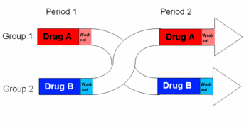
SMARTs vs Crossover Trials
Differences
SMARTs
evaluate DTRs
treatment allocation adapts to a subject’s intermediate outcome
attempt to capture carryover (i.e., delayed) effects
Crossover
evaluate stand-alone treatments
everyone switches treatment
attempt to wash out the carryover effects
http://en.citizendium.org/wiki/Cross-over_study

Slide 70
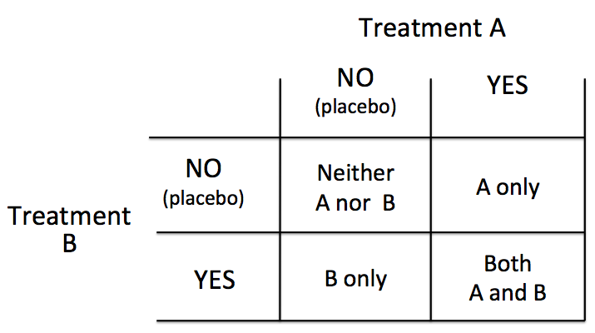
SMARTs vs Factorial Trials
Differences
SMARTs
use repeated randomization dependent on intermediate outcomes
treatments are given over time based on response
take advantage of treatment interaction
Factorial designs
treatment given at 1 time
often assume active interventions are independent (no treatment interaction/synergy) to achieve 2 trials for the price of 1 whereas
https://www.anzmtg.org/stats/Guides/StudyDesign
Notes:
A SMART is a special type of factorial design where treatments are given in sequence

Slide 71
Alternative Approaches
1. Theory, experience and expert opinion
2. Observational longitudinal data
3. Data from multiple randomized trials

Slide 72
Alternative approaches: Theory & Experts
Use theory, clinical experience and expert opinion to construct DTR and compare to a standard alternative in trial
May not be able to know why your DTR worked
Why and how was each piece of the DTR decided upon
Open up the black box of the DTRs

Slide 73
Alternative approaches: Observational
Can be used to construct DTRs (and have been extensively)
Usual concerns with observational data: confounding and other hidden biases
Rubin 1974
Rosenbaum 1991
Need (often unverifiable) assumptions to make causal inference about treatment effects
Analysis is more complex
Robins 2004
Moodie, Chakraborty and Kramer 2012

Slide 74
Alternative approaches: multiple rcts
Single stage at a time approach
Trial 1: Best initial treatment P vs. E vs. B – choose the best stage 1 treatment (e.g. P)
Trial 2: Best secondary treatment E vs. B – choose the best stage 2 treatment
Run separate trials or trial 1 may have been completed in the past and you can propose a responder or non-responder only trial for trial 2
Combining the best treatment for each stage, obtained from separate randomized trials does not necessarily give you the best DTR

Slide 75
Alternative approaches: multiple RCTs
Potential Problem 1: Delayed Effects
Short term effectiveness of initial treatment does not capture its long term effectiveness when followed by subsequent treatment
Positive Synergies: Treatment E may not appear best initially but may have enhanced long term effectiveness when followed by a particular treatment
Negative Synergies: Treatment P may produce a higher proportion of responders initially but also result in side effects that reduce the effectiveness or variety of subsequent treatments for those that respond or burden imposed by treatment P may be sufficiently high so that non-responders are less likely to adhere to subsequent treatments
Example: In the kidney cancer setting…
Notes:
What appears best initially is not best when considered part of a sequence
We want big positive delayed effects
Positive synergies happen often with behavioral interventions- take a while for intervention to work (little short term gains) but when add something else or provide different context, see huge gain
Negative synergies can happen if initial treatment overburdens individual and results in decreased responsivity to future treatment- see Thall et al 2007, Bembom and van der Laan for example

Slide 76
Alternative approaches: multiple RCTs
Trial 1
Trial 2
Pazopanib
Bevacizumab
No Response (disease progression)
R
R
Everolimus
Entry
Everolimus
Bevacizumab
Find non-responders to P and compare 2nd stage treatments
Response Rate:
B: 10%
E: 20%
Response Rate:
P: 50%
E: 40%
B: 35%

Slide 77
Alternative approaches: multiple RCTs
Trial 1
Trial 2
Pazopanib
Bevacizumab
No Response (disease progression)
R
R
Everolimus
Entry
Everolimus
Bevacizumab
DTRs from 2 trials: 1) P followed by B for non-responders (continue P for responders):
Overall response rate: 50%+50%*10%= 55%
2) P followed by E for non-responders (continue P for responders):
Overall response rate: 50%+50%*20%= 60%
Result: Best DTR is P followed by E for non-responders (continue P for responders)

Slide 78
Alternative approaches: multiple RCTs
But what about the other possible DTRs?
First begin with E, if you respond continue E, if you do not respond, switch to B
First begin with E, if you respond continue E, if you do not respond, switch to P
First begin with B, if you respond continue B, if you do not respond, switch to P
First begin with B, if you respond continue B, if you do not respond, switch to E
We never tested these! Consider if E is given first (40% response) and then B is given to non-responders (40% response)
Overall response rate for E followed by B for non-responders (continue E for responders) is 40%+60%*40%=64% > 60% for P followed by E for non-responders (continue P for responders)

Slide 79
Alternative approaches: multiple RCTs
Potential Problem 2: Selection Effect: Enrollment
People who enroll single stage trials differ from those in a SMART
We expect those who enroll in a SMART to be more generalizable
Non-responders in single stage trial may not represent the population of non-responders because demoralized people will not join the study
In a SMART: both demoralized and motivated people are included and get re-randomized and you may learn that additional support is needed for demoralized non-responders to re-engage with treatment at second-stage
Notes:
If non-responders to initial treatment are discouraged they may not want to enroll in another trial so those who do enroll are unlikely to represent all non-responders. This selection bias will prevent us from realizing that we may need a behavioral intervention to encourage non-responders to start again with treatment
Note, we know in trials, we already get a more motivated group of folks than general population

Slide 80
Alternative approaches: multiple RCTs
Potential Problem 2: Selection Effect: Enrollment
People who enroll single stage trials differ from those in a SMART
Example: In the kidney cancer setting, if we ran separate RCTs, we may expect that those in the non-responder RCT includes only the highly motivated non-responders (those not discouraged they did not respond) whereas, if we enroll in a SMART, there may be more heterogeneity in the type of participants because they know there are options if they do not respond initially
Notes:
If non-responders to initial treatment are discouraged they may not want to enroll in another trial so those who do enroll are unlikely to represent all non-responders. This selection bias will prevent us from realizing that we may need a behavioral intervention to encourage non-responders to start again with treatment
Note, we know in trials, we already get a more motivated group of folks than general population

Slide 81
Alternative approaches: multiple RCTs
Potential Problem 3: Selection Effect: Adherence/Drop out
Patients are more likely to adhere/remain in a SMART
In a single stage RCT, patients are offered a fixed treatment
Those who are not improving have no other option besides non-adherence or drop out
In a SMART, patients may have alternative treatment options if they do not respond or less burdensome treatment options if they do respond
Lead to enhanced motivation to adhere and remain in study

Slide 82
Alternative approaches: multiple RCTs
Potential Problem 3: Selection Effect: Adherence/Drop out
Patients are more likely to adhere/remain in a SMART
Moodie et al. in Trials (2016) found great retention in (1) SMART than traditional trial designs
Example: In the kidney cancer setting, we might expect more individuals to remain in the SMART (and adhere to treatment) because if they do not initially respond, there is a second treatment option, whereas in a standard trial, if the patient doesn’t respond early, they may not continue to take the medication or engage in the trial

Slide 83
Alternative approaches: multiple RCTs
Potential Problem 4: Prescriptive Effects
Single stage trials provide limited options to explore ways to more deeply individualize (tailor) the DTR
May be unable to find other intermediate tailoring variables that allow us to best match second stage treatment in standard RCTs that lead to best DTRs

Slide 84
Alternative approaches: multiple RCTs
Potential Problem 4: Prescriptive Effects
Single stage trials provide limited options to explore ways to more deeply individualize (tailor) the DTR
Example: In the kidney cancer setting,
Treatment E may lead to a lower proportion of responders than treatments P and B
But, treatment E may elicit some symptoms (e.g., grade 3 neuropathy) that allows us to better match the patient with a second stage treatment
For this group of patients tailored on response and symptoms, the sequence may have a better outcome than the initial treatments

Slide 85
SMART Summary
Capture delayed intervention effects resulting from positive or negative synergy
Account for effects of subsequent treatment when comparing and evaluating initial treatments
Improve adherence and reduce attrition among participants who are not responding to the initial intervention
Include a sample of non-responders that have a broader representation of the population of non-responders
Capture data that will enable use to more deeply tailor future DTRs for optimal outcomes
Notes:
Slide from Danny Almirall, Anahlee Brinks and Billie Nahum-Shani
http://d3lab-isr.com/wp-content/uploads/2018/04/MODULE2_SMART.pdf

Slide 86
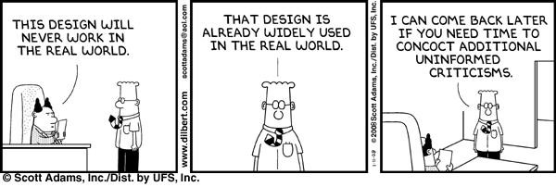

Slide 87
Practice Exercise
Pick a number out of a hat
In sequential order, draw a SMART design, each person after needs to make their SMART look different
Use A,B,C,… as treatments
Use response/non-response as intermediate outcome
How many DTRs are in each design?

Slide 88
Part 2
SMART Design Principles

Slide 89
Objectives: Part 2
SMART design principles
Primary Aims
Sample Size
Secondary Aims

Slide 90
SMART Design principals: KISS
Focus on a few scientific questions that you would like to answer to develop DTRs
Use a well justified intermediate outcome and individualization (tailoring) variables to restrict randomization based on ethical, scientific and practical considerations
Reliability and generalizability
Use a low dimension summary instead of all intermediate outcomes to restrict class of next treatments
How do you define responders and non-responders; can others use this definition?

Slide 91
SMART Design principals: KISS
At each critical decision point, restrict the class of interventions based on ethical, feasible, or strong scientific considerations
Collect intermediate outcomes needed to ascertain intermediate outcome (e.g. responder status)
Collect intermediate outcomes that might be useful in ascertaining for whom each intervention works best (individualization/tailoring variables)
Information that may later enter into DTR

Slide 92
SMART Design principals: KISS
Choose a primary hypothesis
Scientifically important
Aids in developing DTR
Power to address this hypothesis
Choose secondary hypotheses
Further develop DTRs
Trial may not be powered to address these hypotheses

Slide 93
Primary Aims of A SMART
1. Comparison of initial treatment options
When sample size is highly constrained
When scientific question has not been addressed and DTRs are not primary focus
Controls for second-stage intervention options
Hypothesis: H₀: P=E=B when given as an initial treatment for renal cell carcinoma

Slide 94
Primary Aims of A SMART
1. Comparison of initial treatment options
Example:
Hypothesis: H₀: P=E=B when given as an initial treatment for renal cell carcinoma

Slide 95
SMART: Case Study 1
Responders
Continue
Pazopanib
Non-responders
Everolimus
R
Bevacizumab
Responders
Continue
R
Everolimus
Non-responders
Pazopanib
Entry
R
Bevacizumab
Responders
Continue
Bevacizumab
Non-responders
Pazopanib
R
Everolimus
months
T = 0
T = 1
T = 5 years
Notes:
P, B are VEGF pathway inhibitors – block the tumor’s blood supply
E inhibits rapamycin (mTOR) pathway which is a central regulator of cell metabolism, growth, proliferation and survival

Slide 96
Primary Aims of A SMART
2. Comparison of second stage treatment options (for non-responders)
When sample size is less constrained
When scientific question has not been addressed and DTRs are not primary focus
Controls for first-stage intervention options
Notes:
Because of the randomizations, we are ruling out alternative explanations like severity at baseline (for the effect of first stage) or adherence as alternative explanation: people who do not adhere will be switch, so all switched people are non-adherent (for the second-stage)

Slide 97
Primary Aims of A SMART
2. Comparison of second stage treatment options (for non-responders)
Example:
Hypothesis: H₀: For non-responders to P, is E=B
In other SMARTs, the second-stage may be strategy based (e.g., switch vs. add treatment), you can combine across first-stage treatments and test strategies
Notes:
Because of the randomizations, we are ruling out alternative explanations like severity at baseline (for the effect of first stage) or adherence as alternative explanation: people who do not adhere will be switch, so all switched people are non-adherent (for the second-stage)

Slide 98
SMART: Compare treatments for non-responders
Responders
Continue
Pazopanib
Non-responders
Everolimus
R
Bevacizumab
Responders
Continue
R
Everolimus
Non-responders
Pazopanib
Entry
R
Bevacizumab
Responders
Continue
Bevacizumab
Non-responders
Pazopanib
R
Everolimus
months
T = 0
T = 1
T = 5 years
Notes:
P, B are VEGF pathway inhibitors – block the tumor’s blood supply
E inhibits rapamycin (mTOR) pathway which is a central regulator of cell metabolism, growth, proliferation and survival

Slide 99
SMART: Compare strategies among non-responders
Responders
Continue
Pazopanib
Non-responders
Bevacizumab
R
Increase dose of Pazopanib
R
Entry
Responders
Continue
Bevacizumab
Non-responders
Pazopanib
R
Increase dose of Bevacizumab
months
T = 0
T = 1
T = 5 years
Notes:
P, B are VEGF pathway inhibitors – block the tumor’s blood supply
E inhibits rapamycin (mTOR) pathway which is a central regulator of cell metabolism, growth, proliferation and survival

Slide 100
Primary Aims of A SMART
3. Comparison of embedded DTRs
When sample size is less constrained
When DTRs are of primary focus
Notes:
Because of the randomizations, we are ruling out alternative explanations like severity at baseline (for the effect of first stage) or adherence as alternative explanation: people who do not adhere will be switch, so all switched people are non-adherent (for the second-stage)
See if interaction between 1st and 2nd stage treatments- synergies or antagonisms

Slide 101
Primary Aims of A SMART
3. Comparison of embedded DTRs
Example:
Hypothesis: H₀: DTR 1 = DTR 2
Begin with P, if you respond continue P, if you do not respond, switch to B =
Begin with B, if you respond continue B, if you do not respond, switch to P
Notes:
Because of the randomizations, we are ruling out alternative explanations like severity at baseline (for the effect of first stage) or adherence as alternative explanation: people who do not adhere will be switch, so all switched people are non-adherent (for the second-stage)
See if interaction between 1st and 2nd stage treatments- synergies or antagonisms

Slide 102
SMART
Responders
Continue
Pazopanib
Non-responders
Everolimus
R
Bevacizumab
Responders
Continue
R
Everolimus
Non-responders
Pazopanib
Entry
R
Bevacizumab
Responders
Continue
Bevacizumab
Non-responders
Pazopanib
R
Everolimus
months
T = 0
T = 1
T = 5 years
Notes:
P, B are VEGF pathway inhibitors – block the tumor’s blood supply
E inhibits rapamycin (mTOR) pathway which is a central regulator of cell metabolism, growth, proliferation and survival

Slide 103
Sample Size
3. Comparison of embedded DTRs
Sample size formula is NOT standard
Analysis is not standard (see more later)
Individuals can be consistent with more than 1 DTR
Design restricts randomization to some groups
E.g., In our trial: in any DTR, the responders are over-represented (they were not re-randomized) and non-responders are under-represented (non-responders were re-randomized so only half are in any DTR)
Notes:
Assuming equal randomization among treatments

Slide 104
Sample Size
3. Comparison of embedded DTRs
Sample size formula is NOT standard and depends on the design
formulae for continuous and binary outcomes tomorrow (after introducing weighted and replicated regression
Notes:
Assuming equal randomization among treatments

Slide 105
Sample Size
3. Comparison of embedded DTRs
Sample size formula is NOT standard
For this Trial: (using Li & Murphy’s applet: weighted log rank test)
Assume randomization probabilities= 0.5
Compare: First begin with P, if you respond continue P, if you do not respond, switch to B = First begin with B, if you respond continue B, if you do not respond, switch to P
Alpha=0.05, Power=0.8, Hazard Ratio of interest: 1.25, probability of observing an event before end of study if all subjects were assigned (P,B)=40%
N=101 (assumes a 4 DTR study)
Our N = 101/2*3 = 153
Notes:
Unlike most other survival calculators, you do not need to specify the time to accrual or length of follow up, variance calculator that would consider those things is just an upper bound, so do not need to level of detail

Slide 106
Sample Size
3. Comparison of embedded DTRs
Sample size formulae are NOT standard
Sample Size calculators:
Continuous
Finding the best DTR: http://methodologymedia.psu.edu/smart/samplesize
Comparing 2 DTRs: https://sites.google.com/umich.edu/kidwell/applets
Binary
Comparing 2 DTRs: https://sites.google.com/umich.edu/kidwell/applets
Survival
Comparing 2 DTRs: http://methodologymedia.psu.edu/logranktest/samplesize
Notes:
Longitudinal calc in the works

Slide 107
Primary Aims of A SMART: Less useful
Compare the initial treatments in terms of the intermediate outcome (proportions of responders)
Focuses on short-term effects
Does not consider the implications of the second-stage options
Makes sense only if all second-stage options are equally effective

Slide 108
Secondary AIMs of a Smart
Secondary hypotheses further develop the DTR
Find more personalized DTRs
Find baseline variables that may be useful in making decisions about 1st stage treatment
Find other intermediate individualizing/tailoring variables (other than response) that may be useful in making decisions about 2nd stage treatment
Notes:
Here, the goal is to discover and propose an AI in which the treatment is more deeply-tailored than the four AIs that are embedded in the SMART design (i.e., beyond those specified in Table 2). Practically, this aim involves identifying tailoring variables beyond those that are embedded in a SMART.
The optimization aim concerns the identification of baseline tailoring variables that might be useful in making decisions about first-stage treatment (duration of first-stage IBT), as well as other intermediate tailoring variables, other than response/nonresponse based on a 5-lb change in weight, that might be useful in making decisions about second-stage treatment

Slide 109
Secondary AIMs of a Smart
Secondary hypotheses further develop the DTR
Examples:
Are those with higher grade of cancer more likely to respond initially with a particular treatment?
Are the number of prior treatments associated with response to initial treatment?
Is the size of the tumor at progression associated with the efficacy of the second-stage treatment?
Notes:
Here, the goal is to discover and propose an AI in which the treatment is more deeply-tailored than the four AIs that are embedded in the SMART design (i.e., beyond those specified in Table 2). Practically, this aim involves identifying tailoring variables beyond those that are embedded in a SMART.
The optimization aim concerns the identification of baseline tailoring variables that might be useful in making decisions about first-stage treatment (duration of first-stage IBT), as well as other intermediate tailoring variables, other than response/nonresponse based on a 5-lb change in weight, that might be useful in making decisions about second-stage treatment

Slide 110
Primary Data Analysis
DTR Estimation and Comparison through Weighted and Replicated Regression

Slide 111
Estimating outcomes for each DTR simultaneously
Efficiently, we can use the entire dataset and estimate and compare the DTRs with 1 regression analysis
Using weighted and replicated regression
Continuous
Binary
Count

Slide 112
A Generic SMART Example (Case Study 1 Cut)
Subgroup
A
B
C
D
E
F
A₁=1
Response
maintenance
No Response
A₂=1
R
R
A₂=-1
Response
A₁=-1
maintenance
No
Response
A₂=1
R
A₂=-1
O₁
O_{2,} R
Y
Notes:
Using contrast coding, but could use dummy or any coding of choice
O1= baseline variables
O2=variables before/at time of randomization
R= response status, 1=responder, 0 if not
Y = outcome

Slide 113
A Generic SMART Example (Case Study 1 Cut)
Subgroup
A
B
C
D
E
F
A₁=1
Response
maintenance
No Response
A₂=1
R
R
A₂=-1
Response
A₁=-1
maintenance
No
Response
A₂=1
R
A₂=-1
O₁
O_{2,} R
Y
Notes:
Using contrast coding, but could use dummy or any coding of choice
O1= baseline variables
O2=variables before/at time of randomization
R= response status, 1=responder, 0 if not
Y = outcome

Slide 114
A Generic SMART Example (Case Study 1 Cut)
Subgroup
A
B
C
D
E
F
A₁=1
Response
maintenance
No Response
A₂=1
R
R
A₂=-1
Response
A₁=-1
maintenance
No
Response
A₂=1
R
A₂=-1
O₁
O_{2,} R
Y
Notes:
Using contrast coding, but could use dummy or any coding of choice
O1= baseline variables
O2=variables before/at time of randomization
R= response status, 1=responder, 0 if not
Y = outcome

Slide 115
A Generic SMART Example (Case Study 1 Cut)
Subgroup
A
B
C
D
E
F
A₁=1
Response
maintenance
No Response
A₂=1
R
R
A₂=-1
Response
A₁=-1
maintenance
No
Response
A₂=1
R
A₂=-1
O₁
O_{2,} R
Y
Notes:
Using contrast coding, but could use dummy or any coding of choice
O1= baseline variables
O2=variables before/at time of randomization
R= response status, 1=responder, 0 if not
Y = outcome

Slide 116
Issues
By design, in SMART designs, subgroups of participants are consistent with more than 1 DTR
E.g., in the example SMART, the responders to initial treatment A1=1 are consistent with 2 DTRs: (A1=1, A2=1), (A1=1, A2=-1)
To estimate the mean outcome under all DTRs simultaneously, we have to share the subgroup consistent with more than 1 DTR
Trick software into using this data twice by replicating it
To fix the imbalance by design that some subgroups have in being represented in DTR, we weight the data
Robust (sandwich) errors account for weighting and the fact that subgroups are re-used

Slide 117
Weighted and replicated Data
Responders were not given treatment assignments in A₂. Their rows are duplicated. One row is assigned A₂ =1, and the other is assigned A₂ =-1. Thus, each row corresponds to one DTR. Responder data is now associated with both DTRs where A₁=1.
Non-responders will have a single row associated with the DTR consistent with the treatment sequence they experienced.
id | A1 | R | A2 | Y | O11 | O12 | O13
101 | 1 | 1 | -1 | 272 | 1 | 32 | 2
101 | 1 | 1 | 1 | 272 | 1 | 32 | 2
102 | 1 | 0 | 1 | 281 | 0 | 38 | 4
103 | 1 | 1 | -1 | 405 | 1 | 23 | 2
103 | 1 | 1 | 1 | 405 | 1 | 23 | 2
104 | -1 | 0 | -1 | 355 | 1 | 57 | 4
105 | 1 | 1 | -1 | 347 | 0 | 47 | 2
105 | 1 | 1 | 1 | 347 | 0 | 47 | 2
… | … | … | … | … | … | … | …
200 | -1 | 1 | -1 | 303 | 1 | 39 | 2
200 | -1 | 1 | 1 | 303 | 1 | 39 | 2
e.g., Responder
e.g., Non-responder

Slide 118
Weighted and Replicated regression model Example
Basic marginal model (design dependent equation):
Where
X is a vector of centered co-variates (e.g., O11, O12, O13),
$a_{1}$ is the first randomization assignment
$a_{2}$ is the second randomization assignment
Note this parametrization assumes second-stage strategies/tactics or the same second stage treatment
$E_{{(a}_{1,}a_{2})}\left(Y | X\right)=ηX+β_{0}+β_{1}a_{1}$+ $β_{2}a_{2}$ +$β_{3}a_{1}a_{2}$

Slide 119
Weighted and Replicated regression
Weighted, replicated data is required to:
Prevent bias
Allow all DTRs to be compared simultaneously
Requires robust standard errors
Uses GEE for estimation
Models differ by design, treatment options and assumptions imposed on interactions between 1st and 2nd stage treatments

Slide 120
Weighting
Imbalance by design
Imbalance will cause bias in estimates if we do not account for it, so we assign weights derived from the probability of being given a particular assignment
Weights are assigned according to inverse of probabilities: Since P(A₁)=.5 and P(A₂|nonresponse)=.5, W_{R}=2 and W_{NR}=4
Response
1
A₁=1
maintenance
.5
R
No Response
A₁=1, A₂=1
.5
R
.5
A₁=1, A₂=-1

Slide 121
Gaining efficiencies in weighting
In addition to design weights (previous slide)
Robins and colleagues (1995), Hirano et al (2003) and others describe potential gains in statistical efficiency by estimating the weights using auxiliary baseline (L₁) and time-varying (L₂) covariate information
Example:
The observed data is {L_{1i} ; X_{i} ; A_{1i} ; L_{2i} ; A_{2i}; Y_{i}}
Use logistic regression to get $\hat{p}$_{1i} = $\hat{P}$ (A₁|L₁, X)
Use logistic regression to get $\hat{p}$_{2i} = $\hat{P}$ (A₂|L₁, X, L₂ , non-response)
Use W_{Ri}=1/$\hat{p}$_{1i} , W_{NRi}=1/($\hat{p}$_{1i} $\hat{p}$_{2i})
Key is to use L’s that are highly correlated with Y
Notes:
p-hats are patient-specific

Slide 122
Review of weighting and replication
Those who responded to A₁=1, form part of 2 interventions:
Offer A₁=1. If patient responds, then continue. If disease progresses, then offer A₂=1
Offer A₁=1. If patient responds, then continue. If disease progresses, then offer A₂=-1
Response
A₁=1
maintenance
R
No
Response
A₁=1, A₂=1
R
A₁=1, A₂=-1

Slide 123
Estimating Equation
The weighted and replicated estimator for β is obtained by solving the following estimating equation:
0=$\sum_{i=1}^{N}{\sum_{(a_{1},a_{2})}{I}}\text{\{} \text{a}\text{1}\text{, }\text{a}\text{2}\text{\}}\text{d}\text{(}\text{Xi}\text{, }\text{a}\text{1}\text{, }\text{a}\text{2}\text{)}\text{Wi}\text{ ∙ (}\text{Y} \text{− }μ\text{(}\text{Xi}\text{, }\text{a}\text{1}\text{, }\text{a}\text{2}\text{; }\text{β}\text{, }\text{η}\text{))}$
Where…
I{a₁,a₂}: treatment sequence of individual i consistent with protocol {a₁,a₂}:
Y: The outcome at end of study
μ : The marginal mean of Y
W_{i}: Inverse-proportioned weights for each individual.
d(X_{i}, a₁, a₂) Derivative with respect to β.

Slide 124
Estimating means and contrasts
Simple linear combinations with beta coefficients: (design dependent equation)
With the above formula, and coding of $a_{1} =\{1,−1\}$ and $a_{2} =\{1,−1\}$, and zero-centered covariates, the following linear combinations can be used:
Estimated mean for
DTR {1,1} = $β_{0}+β_{1}$ $+$ $β_{2}$ $+ β_{3}$
DTR {1,-1} = $β_{0}+β_{1}$ $−$ $β_{2}$ $− β_{3}$
DTR {-1,1} = $β_{0}−β_{1}$+ $β_{2}$ $− β_{3}$
DTR {-1,-1} = $β_{0}−β_{1}$ $−$ $β_{2}$ +$β_{3}$
Contrasts are found by subtracting. So DTR{1,1} – DTR{1,-1} is ${2β}_{2}$ +${2β}_{3}$
$E_{{(a}_{1,}a_{2})}\left(Y | X\right)=ηX+β_{0}+β_{1}a_{1}$+ $β_{2}a_{2}$ +$β_{3}a_{1}a_{2}$
Notes:
Note this parametrization assumes second-stage strategies/tactics or the same second stage treatment

Slide 125
Gaining efficiencies in Estimation
Adjusting for baseline covariates (e.g., o11, o12, o13) that are associated with the outcome leads to more efficient estimates
Lower standard errors
Tighter confidence intervals
More power
Smaller p-value

Slide 126
Weighted and replicated data in sas
Data wrdat;set dat;
if R=1 then do;
ob=1; A2=1; w=2; output;
ob=2; A2=-1; w=2; output;
end;
Else if R=0 then do;
ob=1; w=4; output;
end;
Run;

Slide 127
Weighted and replicated Model in sas
proc genmod data = wrdat;
class id;
model y = a1 a2 a1*a2;
scwgt w;
repeated subject = id / type = ind;
estimate ‘MeanY: DTR#1(A1=1,A2=1)' int 1 a1 1 a2 1 a1*a2 1;
estimate 'MeanY: DTR #2(A1=1,A2=-1)' int 1 a1 1 a2 -1 a1*a2 -1;
estimate 'MeanY: DTR #3(A1=-1,A2=1)' int 1 a1 -1 a2 1 a1*a2 -1;
estimate 'MeanY: DTR #4(A1=-1,A2=-1)' int 1 a1 -1 a2 -1 a1*a2 1;
estimate ' Diff: DTR #1 - DTR #2 ' int 0 a1 0 a2 2 a1*a2 2;
estimate ' Diff: DTR #1 - DTR #3 ' int 0 a1 2 a2 0 a1*a2 2;
estimate ' Diff: DTR #1 - DTR #4 ' int 0 a1 2 a2 2 a1*a2 0; *etc...;
run;

Slide 128
Weighted and replicated DATA in R
dat$w[R==1]<-2 #make new variable for weight
dat$w[R==0]<-4
datresp1<-dat[R==1,] #1st dataset of responders setting A2=1
datresp1$A2<-1
datresp2<-dat[R==1,] #2nd dataset of responders setting A2=-1
datresp2$A2<- -1
datnoresp<-dat[R==0,] #dataset of non-responders
Wrdat1<-rbind(datresp1,datresp2,datnoresp) #weighted and replicated dataset
colnames(wrdat1)<-c(“id”,”A1”,”R”,”A2”,”Y”,”O11”,”O12”,”O13”,”w”)
wrdat<-wrdat1[order(wrdat$id),] #sort data by id for gee statement
Notes:
Or use PROC genmod in SAS

Slide 129
Weighted and replicated Model in R
centered covariates
wrfit1 <- gee(formula = y ~ o11c + o12c + o13c +
a1+ a2 + a1:a2,
id=id,
weights = w,
data= wrdat,
family= gaussian,
corstr = "independence")
summary(wrfit1)
Measures the differences between the DTRs
Accounts for replicated data
Incorporates weights
Accounts for type of data

Slide 130
Weighted and replicated estimates in R
library(doBy) #required for esticon function (estimates)
library(aod) #required for wald.test function (contrasts)
meanYdtr1<-esticon(wrfit1,c(1,0,0,0,1,1,1))
meanYdtr2<-esticon(wrfit1,c(1,0,0,0,1,-1,-1))
meanYdtr3<-esticon(wrfit1,c(1,0,0,0,-1,1,-1))
meanYdtr4<-esticon(wrfit1,c(1,0,0,0,-1,-1,1))
pair1vs2<-wald.test(b=coef(wrfit1),Sigma=vcov(wrfit1),L=cbind(0,0,0,0,0,2,2))
pair1vs3<-wald.test(b=coef(wrfit1),Sigma=vcov(wrfit1),L=cbind(0,0,0,0,2,0,2))
pair1vs3<-wald.test(b=coef(wrfit1),Sigma=vcov(wrfit1),L=cbind(0,0,0,0,2,2,0))

Slide 131
Example Results
Linear combinations of the beta estimates can provide the means and contrasts between means with standard errors for each of the DTRs (subset of results, 4 DTRs total):
Means Estimate std. err. Lower CI Upper CI P-value
DTR 1 313.925733 8.251668 297.752463 330.099003 0.0000
DTR 2 304.929205 8.124873 289.004455 320.853956 0.0000
DTR 3 321.589822 8.821829 304.299037 338.880606 0.0000
(etc.)
Contrasts
DTR1 – DTR2 8.996528 6.054976 -02.871225 20.864281 0.1373
DTR1 – DTR3 -7.664088 9.318079 -25.927524 10.599347 0.4108
DTR1 - DTR4 -1.068808 9.543287 -19.773650 17.636035 0.9108
(etc.)

Slide 132
Adapting to Different Designs
The data set up and model are SMART design dependent for weighted and replicated data
The weights depend on the design-> is there an imbalance in representation in a DTR
The groups of replicated data depend on the design-> who is consistent with more than 1 DTR

Slide 133
DESIGN AND MODEL: Case Study 1 CANCER
E$\left(Y | X\right)=ηX+β_{0}+β_{1}b+β_{2}c$+$β_{3}I(a,c)$+$β_{4}I(a,c)$+$β_{5}I(c,b)$
b=1 if stage 1 treatment = B, 0 otherwise
c=1 if stage 1 treatment = C, 0 otherwise
I(a,c)= 1 if stage 1 treatment is A and stage 2 treatment = C, 0 otherwise
I(b,c)= 1 if stage 1 treatment is B and stage 2 treatment = C, 0 otherwise
I(c,b)= 1 if stage 1 treatment is C and stage 2 treatment = B, 0 otherwise
Notes:
Parametrized to allow 2nd stage treatment to differ and have different effects for each first stage treatment
Still replicate responders, just create new variables for indicators

Slide 134
DESIGN AND MODEL: Case Study 1 CANCER (reparametrized)
E$\left(Y | X\right)=ηX+β_{0}+β_{1}I(DTR2)+β_{2}I(DTR$3)+$β_{3}I(DTR4)$+$β_{4}I(DTR5)$+$β_{5}I(DTR6)$
DTR1 = reference, (A, continue, B)
I(DTR2)= 1 if DTR=(A,continue,C), 0 otherwise
I(DTR3)= 1 if DTR=(B,continue,A), 0 otherwise
I(DTR4)= 1 if DTR=(B,continue,C), 0 otherwise
I(DTR5)= 1 if DTR=(C,continue,A), 0 otherwise
I(DTR6)= 1 if DTR=(C,continue,B), 0 otherwise
Notes:
Parametrized by DTR
This parametrization works fine for DTR estimation and can include baseline variables. If you want more specific info about how to personalize DTR where certain variables may interact specifically with 1st stage treatment and 2nd stage treatment differently– this is not a good parametrization

Slide 135
Adapting to Different Designs: Case Study 2 EXTEND
Naltrexone
Each DTR is assigned with equal probability.
Weighting is not needed.
Replicating is still needed.
Each patient will have 2 rows.
A₂ differs for responders and nonresponders, need to be able to match up into permutations.
So use A_{2R} and A_{2NR} .
Responders will have 1 assignment for A_{2R} and the replicated rows will match them up with A_{2NR} =1 and A_{2NR} =-1.
R
Responders
Strict definition: (2 or more drinks is non-response)
Naltrexone + phone counseling
Non-responders
Adherence intervention+ medical management + placebo
R
Adherence intervention+ medical management + naltrexone
R
Naltrexone
Responders
R
Lenient definition: (5 or more drinks is non-response)
Naltrexone + phone counseling
Non-responders
Adherence intervention+ medical management + placebo
R
Adherence intervention+ medical management + naltrexone
Notes:
Similar to case study 2

Slide 136
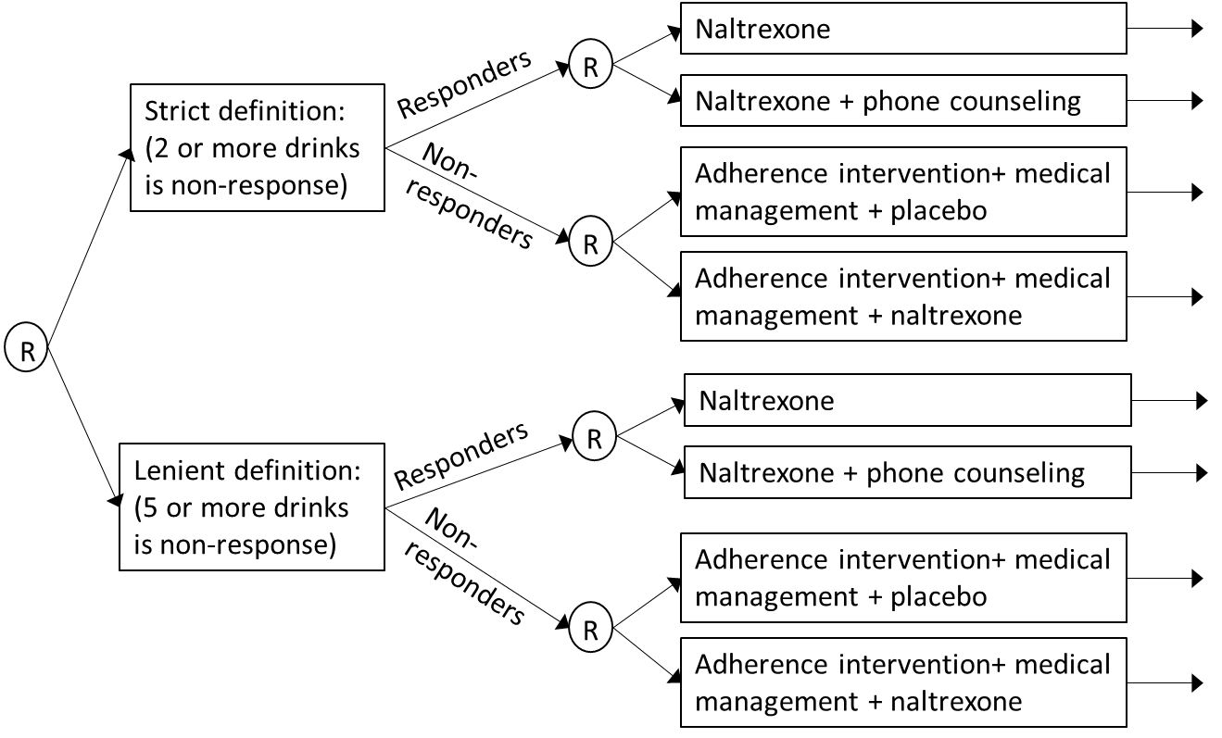
MODEL: Case study 2 EXTEND
$E_{{(a}_{1}{,a}_{2R}{,a}_{2NR})}\left(Y | X\right)$= $ηX+ β_{0}$ + $β_{1}a_{1}$+ $β_{2}a_{2R}$ + $β_{3}a_{2NR}$+$β_{4}a_{1}a_{2R}$
+$β_{5}a_{1}a_{2NR}$+$β_{6}a_{2R}a_{2NR}$+$β_{7}a_{1}a_{2R}a_{2NR}$

Slide 137
weighting and replication DATA: CASE STUDY 2 EXTEND
Responders were not given treatment assignments in A_{2NR}. Their rows are duplicated. One row is assigned A_{2NR} =1, and the other is assigned A_{2NR} =-1. Each row corresponds to one DTR. Responder data is now associated with both DTRs associated with these values of non-responder data.
Non-responders were not given treatment assignments in A_{2R}. Their rows are duplicated. One row is assigned A_{2R} =1, and the other is assigned A_{2R} =-1. Each row corresponds to one DTR. Non-responder data is now associated with both DTRs associated with these values of responder data.
ID | A1 | R | A2R | A2NR | Y | Male | Age
101 | 1 | 1 | -1 | 1 | 272 | 1 | 32
101 | 1 | 1 | -1 | -1 | 272 | 1 | 32
102 | 1 | 0 | 1 | 1 | 281 | 0 | 38
102 | 1 | 0 | -1 | 1 | 281 | 0 | 38
103 | 1 | 1 | 1 | 1 | 405 | 1 | 23
103 | 1 | 1 | 1 | -1 | 405 | 1 | 23
104 | -1 | 0 | 1 | -1 | 355 | 1 | 57
104 | -1 | 0 | -1 | -1 | 355 | 1 | 57
105 | 1 | 0 | 1 | -1 | 290 | 0 | 40
105 | 1 | 0 | -1 | -1 | 290 | 0 | 40
Responder
Note there is no weight column, because this design is balanced.
Non-responder

Slide 138
DESIGN AND Model: Case Study 3 AUTISM
Blended therapy
Early response
Blended therapy
Slow response
DTR 1
Intensified blended therapy
Minimally verbal children
R
DTR 2
R
Blended therapy with speech generating device
Blended therapy plus SGD
Early response
Blended therapy plus SGD
Slow response
DTR 3
Intensified blended therapy plus SGD
$E_{{(a}_{1,}a_{2})}\left(Y | X\right)=ηX+β_{0}+β_{1}a_{1}$+ $β_{2}1_{a_{1}=1}a_{2}$

Slide 139
Weighted and Replicated DATA: Case Study 3 AUTISM
Responders to A₁=1 were not given treatment assignments in A₂. Their rows are duplicated. One row is assigned A₂ =1, and the other is assigned A₂ =-1. Thus, each row corresponds to one DTR.
Non-responders to A₁=1 and all those with A₁=-1 will have a single row associated with the DTR consistent with the treatment sequence they experienced.
ID | A1 | R | A2 | Y | Male | Age | Weight
101 | 1 | 1 | -1 | 272 | 1 | 32 | 2
101 | 1 | 1 | 1 | 272 | 1 | 32 | 2
102 | 1 | 0 | 1 | 281 | 0 | 38 | 4
103 | 1 | 1 | -1 | 405 | 1 | 23 | 2
103 | 1 | 1 | 1 | 405 | 1 | 23 | 2
104 | -1 | 0 | NA | 355 | 1 | 57 | 2
105 | 1 | 0 | 1 | 347 | 0 | 47 | 4
106 | 1 | 0 | -1 | 290 | 0 | 40 | 4
107 | -1 | 1 | NA | 303 | 1 | 39 | 2
Responder
Non-responder

Slide 140
Practice Exercise using Software
ADHD SMART
LOAD ADHD Simulated data into R or SAS
Available at: https://sites.google.com/umich.edu/kidwell/workshops
Use code or try to code it yourself to see results.

Slide 141
ADHD SMART
Variable | Type | Description
O11 | Baseline covariate, binary (0/1) | ODD diagnosis
O12 | Baseline covariate, continuous | ADHD score, larger reflects fewer symptoms
O13 | Baseline covariate, binary (0/1) | Medication prior to 1st stage treatment
O14 | Baseline covariate, binary (0/1) | White (1) vs. non-white
A1 | 1st stage treatment, binary (-1/1) | -1 for MED, 1 for BMOD
R | Response indicator, binary (0/1) | 0 for no-response, 1 if response
O21 | Intermediate outcome, continuous | Number of months until no response
O22 | Intermediate outcome, binary (0/1) | Adherence to initial treatment
A2 | 2nd stage treatment, binary (-1/1, missing for R=1) | For non-responders to 1st treatment, -1 for AUGMENT, 1 for INTENSIFY
Y | Outcome, continuous | School performance at end of school year, higher is better

Slide 142
SMALL Sample SMARTs

Slide 143
Trial Designs in Small Samples/Rare diseases
Rare disease trials are more likely to be
Single arm: 63% vs. 29.6%
Non-randomized: 64.5% vs. 36.1%
Suggested trial designs
Crossover
N-of-1
Adaptive
Need for more innovative trial design
Notes:
Bell & Tudur Smith 2014

Slide 144
Motivation for snSMART
Individuals guaranteed to be on at least 1 drug
Individuals move to a different drug if they do not respond to the first drug
Individuals can stay on a drug if they respond to it in the first stage

Slide 145
SnSMART design
Response
A
A
No Response
B
R
C
Response
B
R
B
No Response
A
R
C
Response
C
C
No Response
A
R
B

Slide 146
CASE STUDY #5: ARAMIS
A randomized multicenter study for isolated skin vasculitis
Population: adults with isolated skin vasculitis
Study Chairs: Christian Pagnoux, MD MPH MSc, Robert Micheletti, MD, Jeffrey Krischer, PhD, Peter Merkel, MD MPH
https://clinicaltrials.gov/ct2/show/results/NCT02939573
Study period: 2018-2022
Interim analysis at n=45
9 sites, through the Vasculitis Clinical Research Consortium
90 individuals
Notes:
Here is study flow of the Engage study.
500 patients enrolled in an intensive outpatient treatment program and provided baseline assessments.
After 2 weeks, 273 (55%) had failed to come to the first weeks of sessions, and were randomized into the study.
½ received a motivational telephone interview in which the counselor tried to enable and motivate patients to attend the original intensive outpatient program that they had enrolled in.
½ received a motivational telephone interview in which the counselor offered a personal choice of treatment options:
Those who then engage in the treatment have no further interventions.
Those who never engaged in the treatment by week 8, are randomized to receive MI-PC or nothing.
Embedded in this SMART are 4 interventions:
*************************************************
½ received a motivational telephone interview in which the counselor tried to enable and motivate patients to attend the original intensive outpatient program that they had enrolled in.
9 hours group-based treatment/week, up to 3 months
Focus on overcoming denial, fostering participation in self-help groups, providing info about process of addiction, cues to relapse.
½ received a motivational telephone interview in which the counselor offered a choice of treatment options:
The original IOP
Cognitive behavioral therapy – up to 12 weekly sessions
Telephone counselling plus stepped-care: an initial face-to-face interview followed by telephone follow up, with stepped up care (more calls or in-person sessions) if the patient isn’t achieving adequate progress
Medication management – was offered only to those with alcohol dependence, since the drug for cocaine use was shown by 2 negative studies to be ineffective early in the recruitment period.

Slide 147
Skin Vasculitis: Background
Uncommon disease, affects <200,000 individuals
Swelling or inflammation of blood vessels
Cutaneous vasculitis lesions can be pruritic, painful and cosmetically disturbing
Associated with discomfort and psychosocial impact
No common preferred or recommended treatment option for isolated skin vasculitis
Different doctors may advise using different drugs, based only on their personal experience

Slide 148
Case Study 6: ARAMIS
Responders
Continue
Azathioprine
Non-responders
Dapsone
R
Colchicine
Responders
Continue
R
Dapsone
Non-responders
Azathioprine
Entry
R
Colchicine
Responders
Continue
Colchicine
Non-responders
Azathioprine
R
Dapsone
months
T = 0
T = 6
T = 12
Notes:
Comparative effectiveness study of 3 most commonly prescribed meds
No placebo: inability to enroll patients, difficulty in blinding study, no clear favorite of drugs to compare to placebo

Slide 149
Small N SMART
Type of multi-stage randomized design where individuals are randomized to a set of treatment options and may be re-randomized at an interim timepoint in the trial
A SMART in small samples
Differentiated due to differing goals

Slide 150
SMART snSMART
*Goal: to construct or compare dynamic treatment regimens (tailored sequences of treatments)
*Goal: to compare treatments by pooling data from all stages to find 1 superior treatment
*Sequential randomization
*Any sample size, often larger
*Subsequent randomization depend on response to previous
*Small sample size (e.g. <200)
*Re-randomization endpoint is an intermediate endpoint; does not have to be overall outcome
*Re-randomization endpoint is the same as the overall outcome

Slide 151
Crossover snSMART
*Goal: to compare treatments within person
*Goal: to compare treatments between patients
*Washout period is required
*Sequential randomization
*No washout period is required
*Find 1 overall best treatment
*Only individuals who do not respond to previous treatment receive a different subsequent treatment
*recruitment and
retention
*All individuals receive (a different) treatment in second stage regardless of response to previous treatment

Slide 152
snSMART Primary objective
Objective: Estimate and compare treatments by pooling data from both stages to find 1 optimal treatment
Outcome: Binary (same outcome at the first and second stage)

Slide 153
SNSMART Secondary Objective
Objective: Estimate and compare the 6 embedded DTRs in the snSMART design
Outcome: Binary (interested in the second stage outcome)

Slide 154
Analysis Approaches
Log Poisson Joint Stage Model
Bayesian Joint Stage Model

Slide 155
Log Poisson Model
Log link to model the mean of the outcome: interpretability
Poisson family to model the variance of the outcome: estimation convergence problems with log-binomial in small samples
Correct variance by using binomial family variance structure in robust sandwich estimators
Notes:
Log link as opposed to logit

Slide 156
Log Poisson Model: Primary aim
$\log\left(E\left[Y_{ik}\right]\right)=\log\left(μ_{ik}\right)=α_{1}I\left(j_{ik}=A\right)+α_{2}I\left(j_{ik}=B\right)+α_{3}I\left(j_{ik}=C\right)$
+$α_{4}Y_{i1}I(k=2)+α_{5}(1−Y_{i1})$ $I(k=2)$
i = subject = 1,….,n
j = treatment = A,B,C
k = stage = 1,2
Notes:
Log link as opposed to logit

Slide 157
Data Format for Log Poisson Model
=0 for stage 1 and =Y₁ for stage 2
=0 for stage 1 and =(1-Y₁) for stage 2
ID | Stage | Treatment K | Outcome Y
1 | 1 | A | 0
2 | 1 | B | 1
3 | 1 | C | 1
… | … | … | …
90 | 1 | B | 0
1 | 2 | C | 0
2 | 2 | B | 0
3 | 2 | C | 1
… | … | … | …
90 | 2 | A | 1
ID | A | B | C | Z₁ | Z₂ | Y
1 | 1 | 0 | 0 | 0 | 0 | 0
2 | 0 | 1 | 0 | 0 | 0 | 1
3 | 0 | 0 | 1 | 0 | 0 | 1
… | … | … | … | 0 | 0 | …
90 | 0 | 1 | 0 | 0 | 0 | 0
1 | 0 | 0 | 1 | 0 | 1 | 0
2 | 0 | 1 | 0 | 1 | 0 | 0
3 | 0 | 0 | 1 | 1 | 0 | 1
… | … | … | … | … | … | …
90 | 1 | 0 | 0 | 0 | 1 | 1

Slide 158
In R
Lpmodeldata<-data.frame(id,A,B,C,Z1,Z2,Y)
Lpmodeldata<- Lpmodeldata[order(geedata$ptid),]
Lpmodel<- summary(gee(Y~XA+XB+XC+Z1+Z2-1, family=poisson(link="log"), data=geedata, id=ptid))$coef
Lpmodelest<- Lpmodel[1:5,1]
Lpmodelse<-Lpmodel[1:5,4]
Lpmodelresponserate<-exp(Lpmodel)[1:3]
Lpmodeldeltamtdse<- Lpmodelresponserate* Lpmodelse[1:3]
Notes:
May need library(gee)

Slide 159
In SAS
Proc sort data= Lpmodeldata; by id;run;
Proc genmod data= Lpmodeldata;
class id;
model y=a b c z1 z2/dist=pois link=log;
repeated subject=id / type=ind;
estimate ‘Log(p) under A’: int 1 a 1 b 0 c 0 z1 0 z2 0;
estimate ‘Log(p) under B’: int 1 a 0 b 1 c 0 z1 0 z2 0;
estimate ‘Log(p) under C’: int 1 a 0 b 0 c 1 z1 0 z2 0;
run;

Slide 160
Log Poisson Model: Secondary aim
$\log\left(E\left[Y_{ik}\right]\right)=α_{1}I\left(j_{ik}=A\right)+α_{2}I\left(j_{ik}=B\right)+α_{3}I\left(j_{ik}=C\right)$
+ $α_{4}I(j_{ik}=A,Y_{i1}=1, k=2)+α_{5}I(j_{ik}=A,Y_{i1}=0 k=2)$
+ $α_{6}I(j_{ik}=B,Y_{i1}=1, k=2)+α_{7}I(j_{ik}=B,Y_{i1}=0 k=2)$
+ $α_{8}I(j_{ik}=C,Y_{i1}=1, k=2)+α_{9}I(j_{ik}=C,Y_{i1}=0 k=2)$
i = subject = 1,….,n
j = treatment = A,B,C
k = stage = 1,2
Notes:
Log link as opposed to logit
Assume Yi1 and Yi2 are independent and use robust sandwich estimator for Cov(a)

Slide 161
Log Poisson Model: Secondary aim
Estimate first stage response rates
$π_{A}= {exp⁡(α}_{1})$
$π_{B}= {exp⁡(α}_{2})$
$π_{C}= {exp⁡(α}_{3})$
Define Linkage Parameters
$β_{1A}= {exp⁡(α}_{4})$ $β_{0A}= {exp⁡(α}_{5})$
$β_{1B}= {exp⁡(α}_{6})$ $β_{0B}= {exp⁡(α}_{7})$
$β_{1C}= {exp⁡(α}_{8})$ $β_{0C}= {exp⁡(α}_{9})$
Estimate DTR response rates
$π_{AAB}=π_{A}$*$β_{1A}$*$π_{A}$ + (1-$π_{A}$)*$β_{0A}$*$π_{B}$
$π_{CCA}=π_{C}$*$β_{1C}$*$π_{C}$ + (1-$π_{C}$)*$β_{0C}$*$π_{A}$
…

Slide 162
Bayesian Joint Stage Model
First stage outcome is Bernoulli and the second stage outcome is modeled conditionally on the first stage outcome using linkage parameters
Uses data from both stage 1 and 2 in estimation and inference (like log Poisson model)
Incorporates investigators’ opinions about response rates
Notation
π_{j}=response rate associated with the first stage treatment j=A,B,C
Β₀π_{j’}=response rate associated with 2nd stage treatment j’ after non-response on treatment k in stage 1
Β₁π_{j}=response rate associated with 2nd stage treatment j after response on treatment k in stage 1

Slide 163
Bayesian Joint Stage Model: Primary Aim
$$Y_{i1j} \sim Bernoulli(π_{j})$$
$$Y_{i2j′}|Y_{i1j},π_{j}\sim Bernoulli({{{(β}_{1}π_{j})}_{}^{Y_{i1j}}{{(β}_{0}π_{j^{′}})}^{1−Y_{i1j}})}_{}$$
i = subject = 1,….,n
j = treatment = A,B,C
k = stage = 1,2

Slide 164
Assumptions for linkage parameters
The linkage parameters do not depend on the initial treatment
Response rate in stage 2 for treatment j is lower than the response rate for treatment k in stage 1: β₀≤1
Maintenance response rate in stage 2 for treatment j is higher in stage 2 than the response rate in stage 1: β₁≥1

Slide 165
Choice of priors
$π_{j}$~Beta(0.4, 1.6)
ARAMIS investigators felt an ineffective treatment would have spontaneous response rate of 20%
Prior sample size of 2
β₀~Beta(1,1)
Equivalent to uniform(0,1)
On average the 2nd stage response rate for non-responders is 0.5*as large as the 1st stage response rate
β₁~Pareto(3,1)
On average the second stage response rate for responders is 1.5*as larger as the first stage response rate

Slide 166
Bayesian Joint Stage Model: Secondary Aim
$$Y_{i1j} \sim Bernoulli(π_{j})$$
$$Y_{i2j′}|Y_{i1j},π_{j}\sim Bernoulli({{{(β}_{1j}π_{j})}_{}^{Y_{i1j}}{{(β}_{0j}π_{j^{′}})}^{1−Y_{i1j}})}_{}$$
i= subject = 1,….,n
j= treatment = A,B,C
k= stage = 1,2
Compute the posterior draws of DTR π_{jjj’} from the following equation using the posterior draws of β_{0j}, β_{1j}, and π_{j}
$π_{jjj′}=π_{j}$($β_{1j}π_{j})+(1−π_{j}$)($β_{0j}π_{j′})$

Slide 167
Bayesian Joint Model in R
Uses R package rjags
Beyond the scope of the workshop today, but if interested in the code, email:
kidwell@umich.edu

Slide 168
Comparator Models
Bayesian Joint Stage Modeling with Multiple Linkage Parameters
Same as BJSM model except the linkage parameters can depend on the initial treatment
Same prior settings as the BJSM.
Bayesian First Stage Model (BFSM)
Same prior settings for $π_{k}$ as the BJSM except we use only the ﬁrst stage data.
Boxian Wei (University of Michigan)
Bayesian snSMART

Slide 169
Simulation Settings
We examined the following statistics of the estimators
Bias
Root mean square error (rMSE)
Coverage rate of 95% credible/confidence interval (not shown here)
Length of 95% CI
Boxian Wei (University of Michigan)
Bayesian snSMART

Slide 170
Simulation SCENARIOS
Scenario 1: No assumptions violated
Scenario 2: Assumptions on Linkage parameters are violated
Table 1: Simulation scenarios for snSMART.
response rate
linkage parameter
Scenario n(trt) π
π
π
β
β
β
β
β
β
A
B
C
0A
0B
0C
1A
1B
1C
1 30
0.2 0.3 0.4
0.6 0.6 0.6 1.5 1.5 1.5
2 30
0.2 0.3 0.4
0.9 0.6 0.3 1.2 1.5 1.8
Boxian Wei (University of Michigan)
Bayesian snSMART

Slide 171
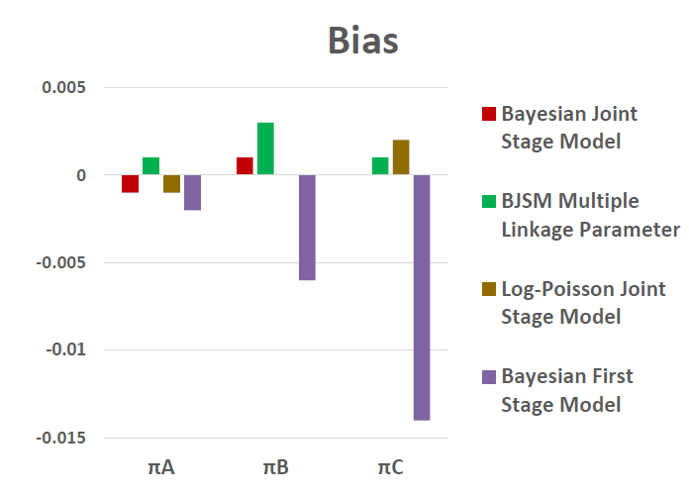
Simulation RESULTS: Scenario 1
Bias is negligible across all methods.
Boxian Wei (University of Michigan)
Bayesian snSMART

Slide 172
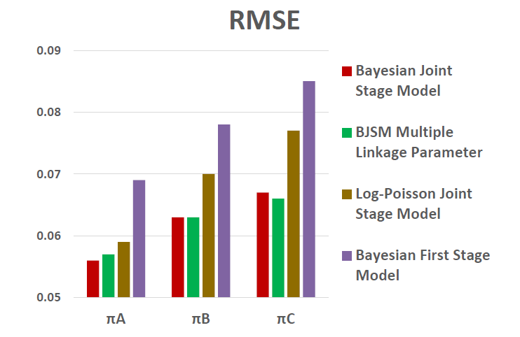
Simulation RESULTS: Scenario 1 cont.
RMSE is smallest with the BJSM.
Boxian Wei (University of Michigan)
Bayesian snSMART

Slide 173
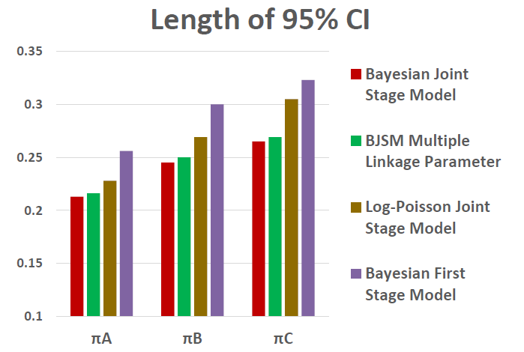
Simulation RESULTS: Scenario 1 cont.
Average 95% CI length is smallest with the BJSM.
Boxian Wei (University of Michigan)
Bayesian snSMART

Slide 174
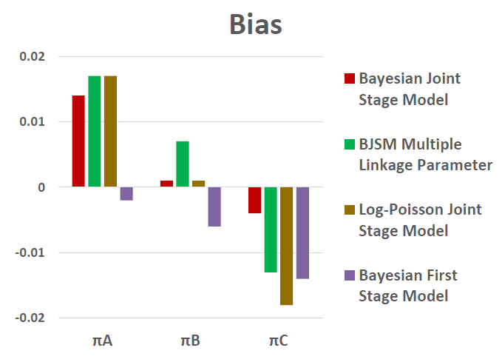
Simulation RESULTS: Scenario 2
Bias is small for all methods.
Boxian Wei (University of Michigan)
Bayesian snSMART

Slide 175
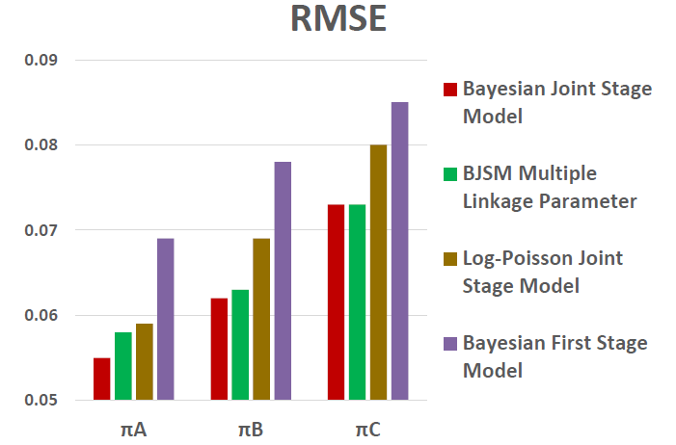
Simulation RESULTS: Scenario 2 (cont)
RMSE is smaller with the BJSM.
Boxian Wei (University of Michigan)
Bayesian snSMART

Slide 176
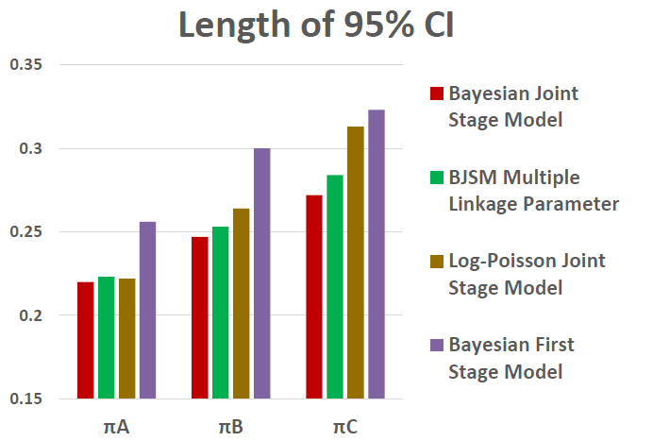
Simulation RESULTS: Scenario 2 (cont)
Average 95% CI length is smaller with the BJSM.
Boxian Wei (University of Michigan)
Bayesian snSMART

Slide 177
Simulation results
When assumptions hold, joint stage Bayesian model has low to no bias, the smallest rMSE, shortest CIs and nominal coverage
When assumptions are violated, joint stage Bayesian model has better properties than the Log-Poisson model model in most settings (may have larger bias, but smaller rMSE)
Allowing the linkage parameters to differ by first stage treatment does not provide a large reduction in bias or rMSE in smaller sample sizes (n<360), so we do not recommend it
Notes:
We ran many simulation scenarios and simulated 2000 realizations per scenario and looked at
Bias: average of the differences between the true value of pik and estimated pik
rMSE: root mean square error: sum of the variance of the estimator and the squared bias of the estimator
Coverage rate of 95% credible/confidence interval (CI): frequency the true value of the response parameter falls
within 95% CI for all simulations
Width of the 95% credible/confidence interval (CI)
Bayesian: highest posterior density CI: narrowest interval that covers 95% of the posterior distribution of pik
Frequentist: based on asymptotic normality of the estimator pik
Considered n=45,90,180; pi’s generally .2,.3,.4

Slide 178
questions

Slide 179
The END
kidwell@umich.edu http://site.google.com/umich.edu/kidwell

Slide 180
Resources
Slides by Billie Nahum-Shani and Danny Almirall
http://www4.stat.ncsu.edu/~davidian/DTRreferences.pdf
Moodie and Kosorok Book: Adaptive Treatment Strategies in Practice: Planning Trials and Analyzing Data for Personalized Medicine (Peter Thall’s Chapter)
Chakraborty, B. and Murphy, S. A. (2014) . Dynamic treatment regimes. Annual Review of Statistics and its Applications, 1, 1.11.18.
Wei et al. (2018). A Bayesian analysis of small n sequential multiple assignment randomized trials (snSMARTs). Statistics in Medicine. 37: 3723-32.
Tamura, et al. (2016). A small n sequential multiple assignment randomized trial design for use in rare disease research. Contemporary Clinical Trials. 46: 48-51.

Slide 181
resources
Hirano, K., et al. Efficient estimation of average treatment effects using the estimated propensity score. 2003. Econometrica 7: 1161-1189.
Lu X et al. Comparing dynamic treatment regimes using repeated‐measures outcomes: modeling considerations in SMART studies. Statistics in Medicine. 2016. 35: 1595-1615.
Murphy, S. A. An experimental design for the development of adaptive treatment strategies. Statistics in Medicine. 2005. 24: 1455-1481.
Nahum-Shani I, et al. Experimental design and primary data analysis methods for comparing adaptive interventions. Psychological Methods. 2012. 17:457-477.
Orellana L, Rotnitzky A, Robins JM. Dynamic regime marginal structural mean models for estimation of optimal dynamic treatment regimes, parts I and II. International Journal of Biostatistics. 2010. 6(2): Article 8 and 9.
Notes:
Here are the major sources referenced during this presentation.

Slide 182
Sample Size Resources
Oetting AI, Levy JA, Weiss RD, Murphy SA. Statistical methodology for a SMART design in the development of adaptive treatment strategies. In Shrout P, Keyes K, Ornstein K (eds). Causality and Psychopathology: Finding the Determinants of Disorders and Their Cures (American Psychopathological Association). American Psychiatric Publishing, Inc., Arlington, VA, 2011, pp. 179–205.
Dawson, R. and Lavori, P.W. Sample Size Calculations for Evaluating Treatment Policies in Multi-stage Designs. Clinical Trials. 2010; 7(6): 643-652.
Ogbagaber SB, Karp J, Wahed AS. Design of sequentially randomized trials for testing adaptive treatment strategies. Statistics in Medicine 2016; 35(6):840–858.
Ghosh, P., Cheung, Y.K., Chakraborty, B. Sample Size calculations for clustered SMART designs. Adaptive Treatment Strategies in Practice: Planning Trials and Analyzing Data for Personalized Medicine. Kosorok & Moodie. 2016. SIAM.
Li Z, Murphy SA. Sample size formulae for two-stage random trials with survival outcomes. Biometrika 2011; 98: 503–18.
Feng W, Wahed AS. Sample size for two-stage studies with maintenance therapy. Stat Med 2009; 28: 2028–41.
Feng W, Wahed AS. Supremum weighted log-rank test and sample size for comparing two-stage adaptive treatment strategies. Biometrika 2008; 95: 695–707.

